Slide 1
DIY weather station
Session 1 of 5
Cary area public library

Slide 2
introduction
Ryan Brock
Software Engineer – 15 Years
Purdue University – Computer Science
Motorola
Zebra Technologies

Slide 3

contact
Twitter: @borq79
Email: borq79@gmail.com
Github Repo: https://github.com/borq79/Cary-Area-Public-Library-Classes
Google Discussion Group: https://groups.google.com/forum/#!forum/cary-area-computer-science-education

Slide 4

goals
Learn how to program the NodeMCU
Learn how to monitor temperature, humidity, pressure, and light intensity
Learn how to create and read a schematic
Learn how to wire up (solder) components on a PCB
Learn how to integrate components and sensors into a single application
Build a functional weather station that can be monitored from the internet

Slide 5

Course plan
Day 1 – January 5th
Introduction
Safety Overview
How to Solder
Solder up BME/BMP280
Day 2 – January 19th
Schematics
Breadboard wire up Test
Configure NodeMCU modules
Thingspeak accounts
Day 3 – February 2nd
How to solder review
DC Socket Assembly
Solder headers
Day 4 – February 16th
PCB wiring
Day 5 – March 2nd
Final assembly and test
Review

Slide 6
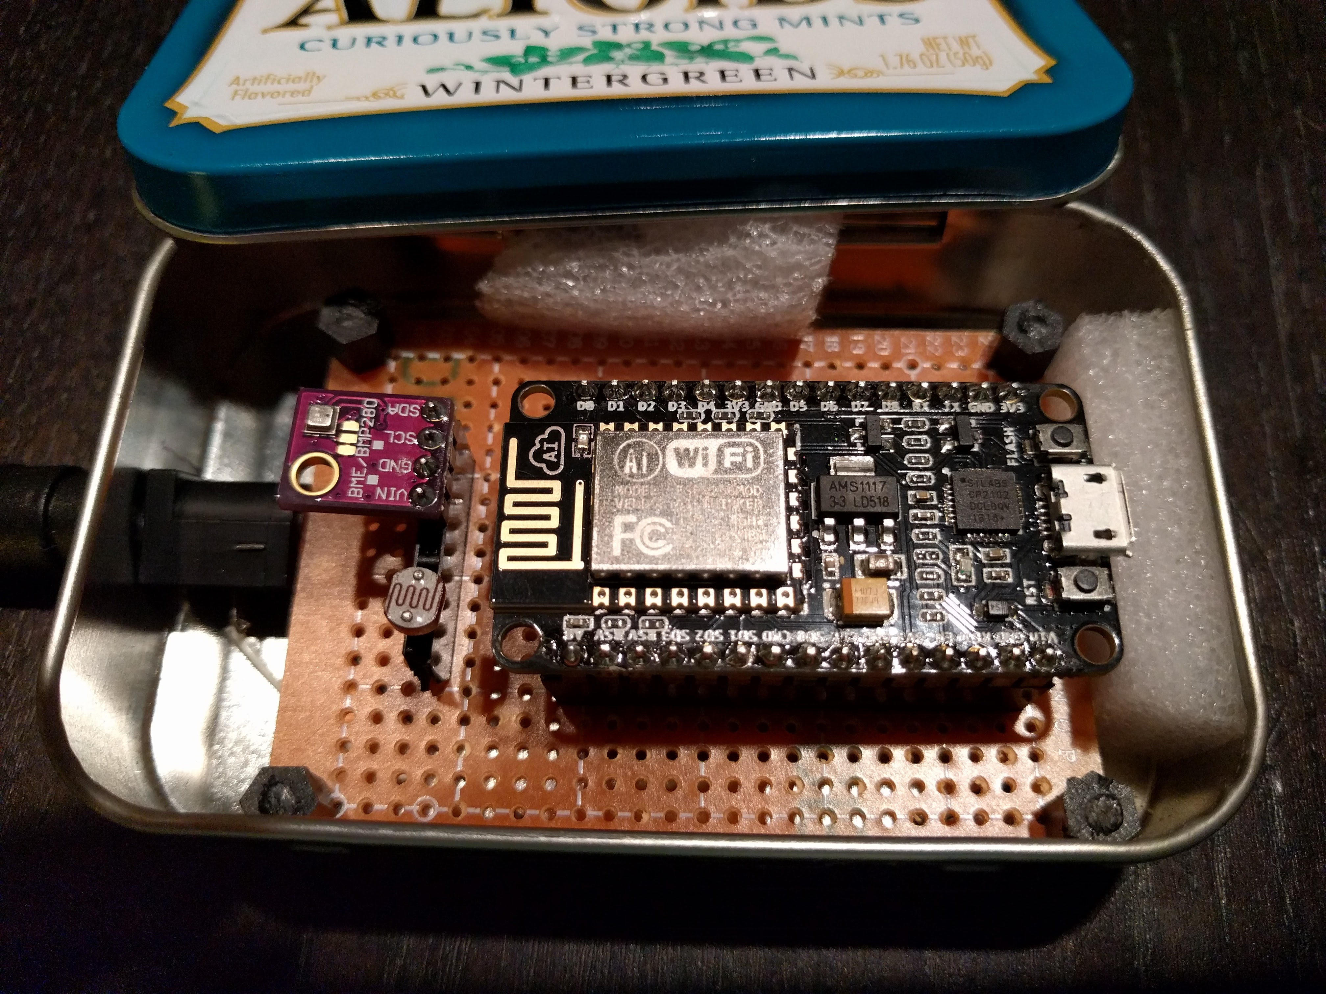
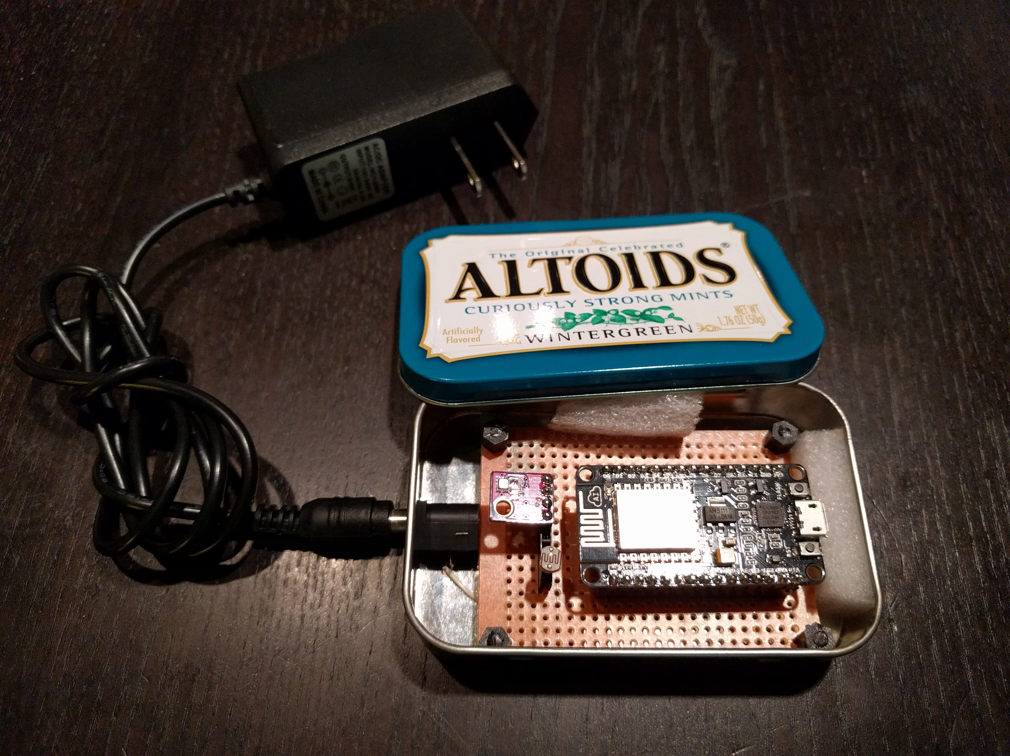
The Weather station
Runs on 9V
Wall or battery powered
Light, temp, humidity, and pressure
Wifi enabled
Sends data to thingspeak
Hosts web server for configuration

Slide 7

Hazards and Warnings
Drilling
Sharp metal edges
Metal Filings
Electricity
Solder
Soldering Iron
EYE PROTECTION REQUIRED

Slide 8
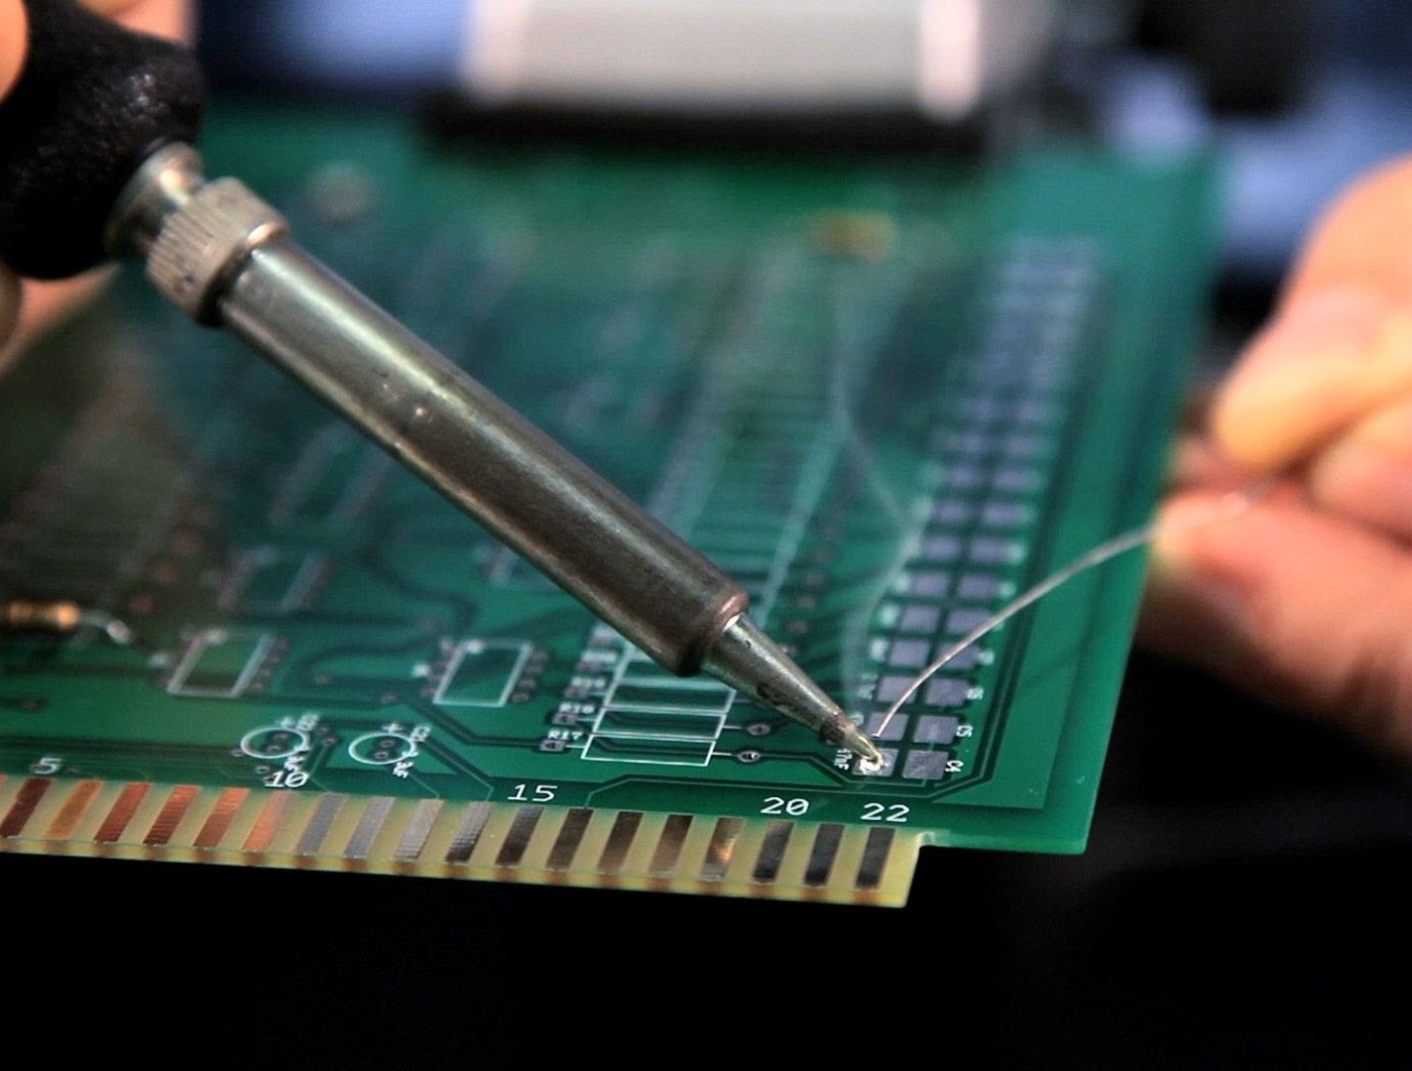
soldering
Be very cautious
300º F to 900º F!
Melt and Fuse Metal
Assume entire rod is hot!
Assume it is always on
Unplug when done and let cool 20 – 25 minutes

Slide 9
Breadboards
Power and ground rows
Columns are connected
Two sides – Gap separated
Grid Layout
Can you Find C:19?

Slide 10

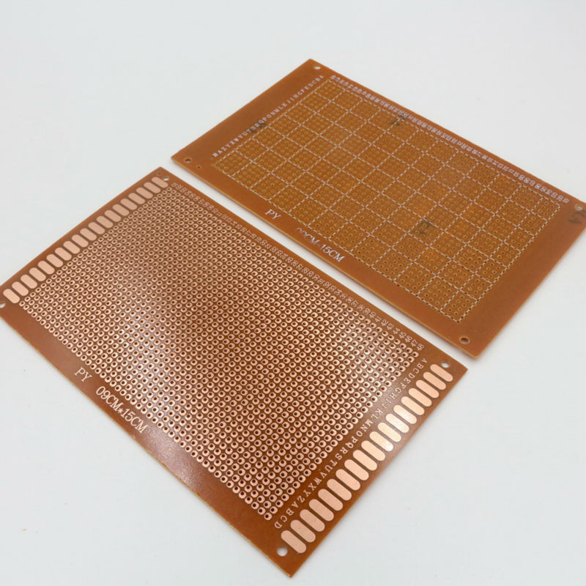
Printed Circuit Boards (PCB)
Similar to breadboard grid layout
Columns are NOT connected
Prototyping
Solder to copper pads

Slide 11
Parts List
Altoids Tin
51K resistor
Photoresistor
DC jack
NodeMCU
BME/BMP280 + Header
3 Female Headers (1 4-pin, 2 15-pin)
5x7 PCB
8 Standoffs
9V Battery Plug
9V Wall Plug

Slide 12
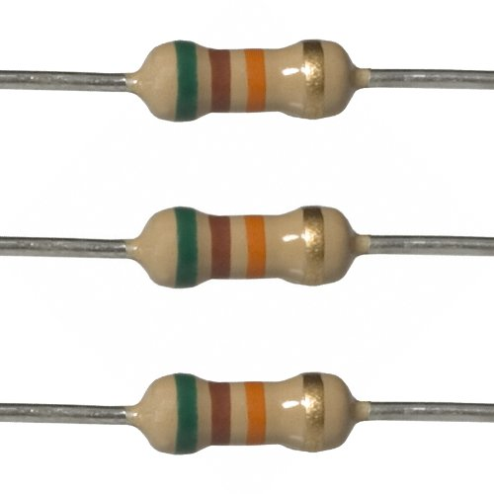
Resistors
Restrict current
Give off heat
Color bands indicate resistance

Slide 13
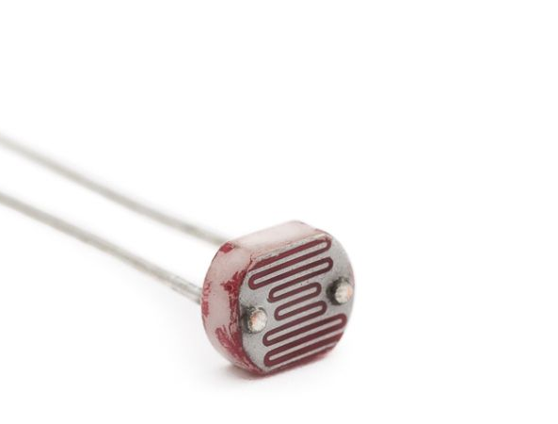
PhotoResistors
Change resistance based on light intensity
Voltage division

Slide 14

Voltage Division
V_{out} = (R₂ ÷ (R₁ + R₂)) * V_{in}

Slide 15
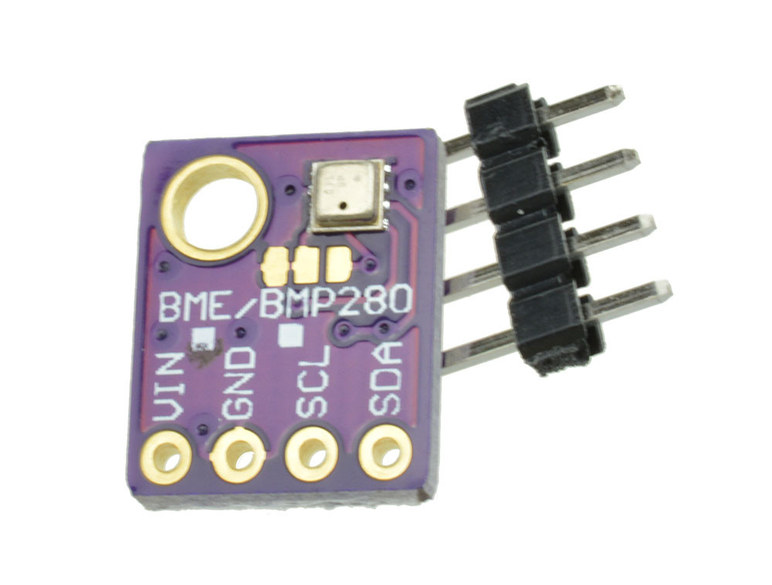
BME/BMP280 Sensor
Vin – 1.8V – 5V
SCL/SDA – i²c or SPI
Temperature
Humidity
Barometric Pressure

Slide 16
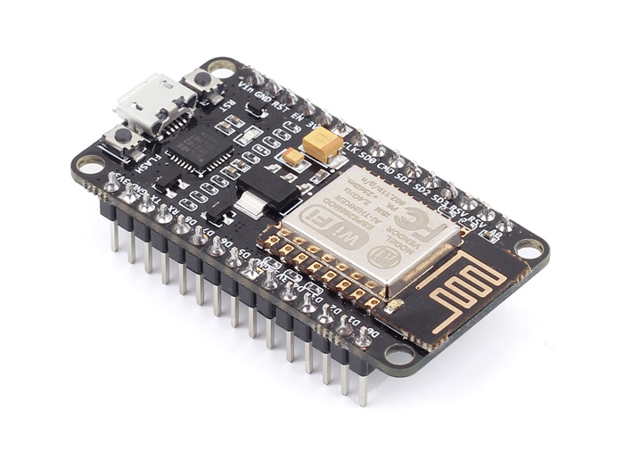
NodeMCU
ESP8266 - ESP-12E
Version 2
Lua Programming Language
3.3V Based
1 Analog Pin
GPIO and PWMs
Input Voltage 5-10V

Slide 17
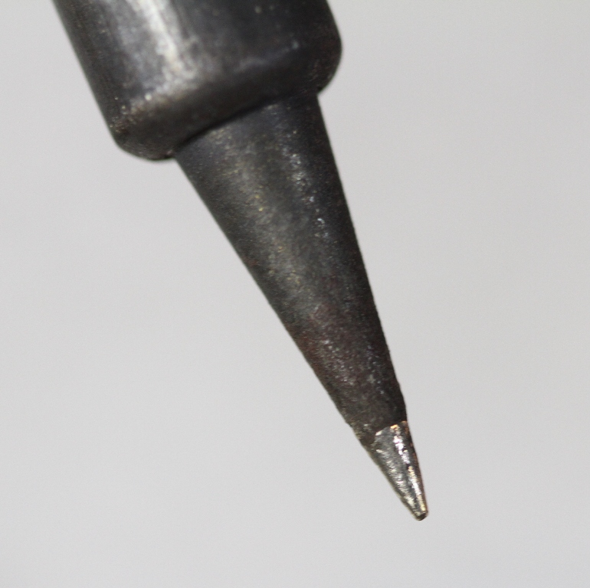
How To Solder
Tin the tip
Images courtesy of Adafriut

Slide 18
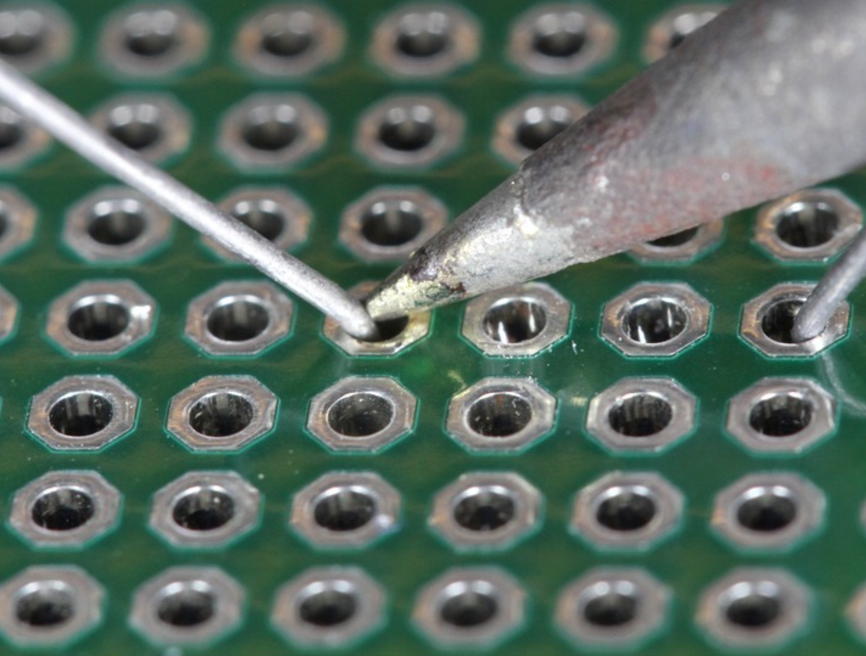
How To Solder
Heat the Joint
Images courtesy of Adafriut

Slide 19
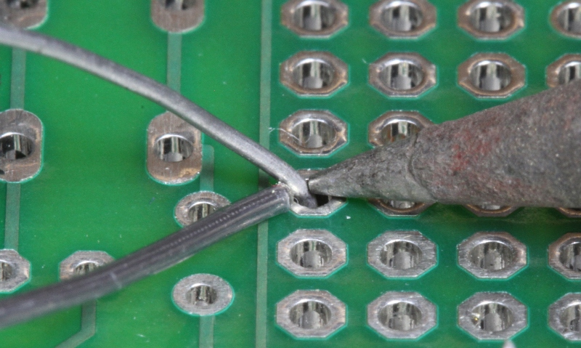
How To Solder
Apply the solder
Images courtesy of Adafriut

Slide 20
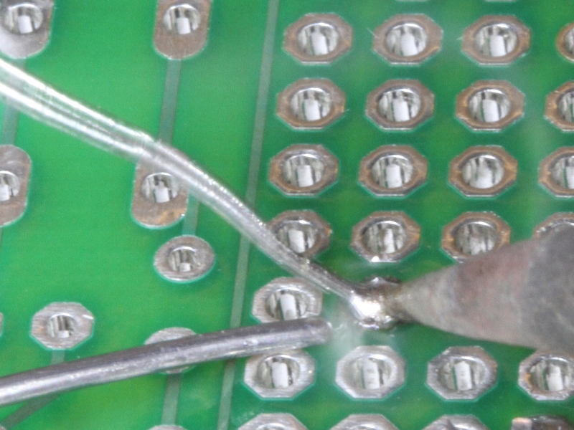
How To Solder
Let it flow
Let it cool
Images courtesy of Adafriut

Slide 21
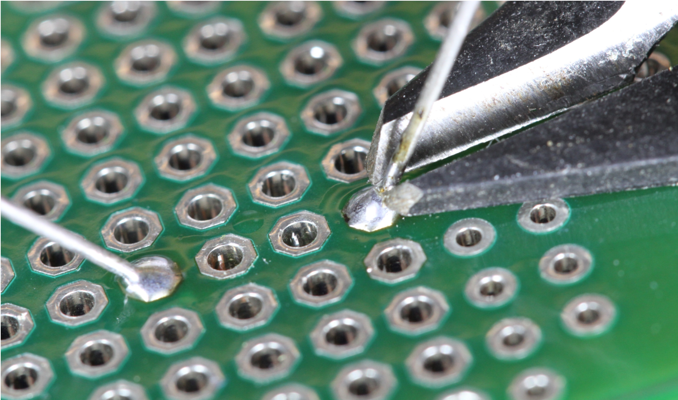
How To Solder
Trim the lead
Images courtesy of Adafriut

Slide 22
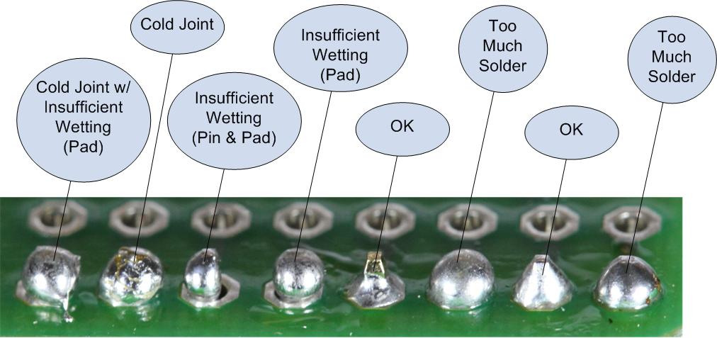
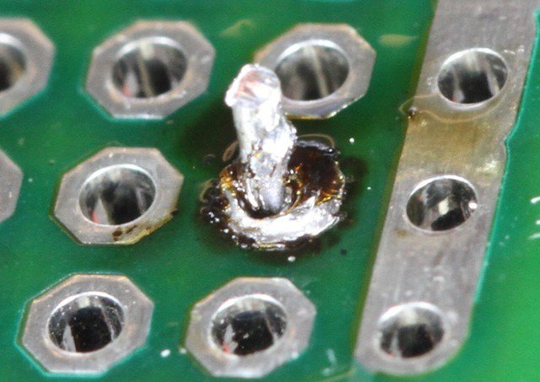
TroubleD Joints
Cold Joints
Insufficient Wetting
Too Much Solder
Images courtesy of Adafriut

Slide 23
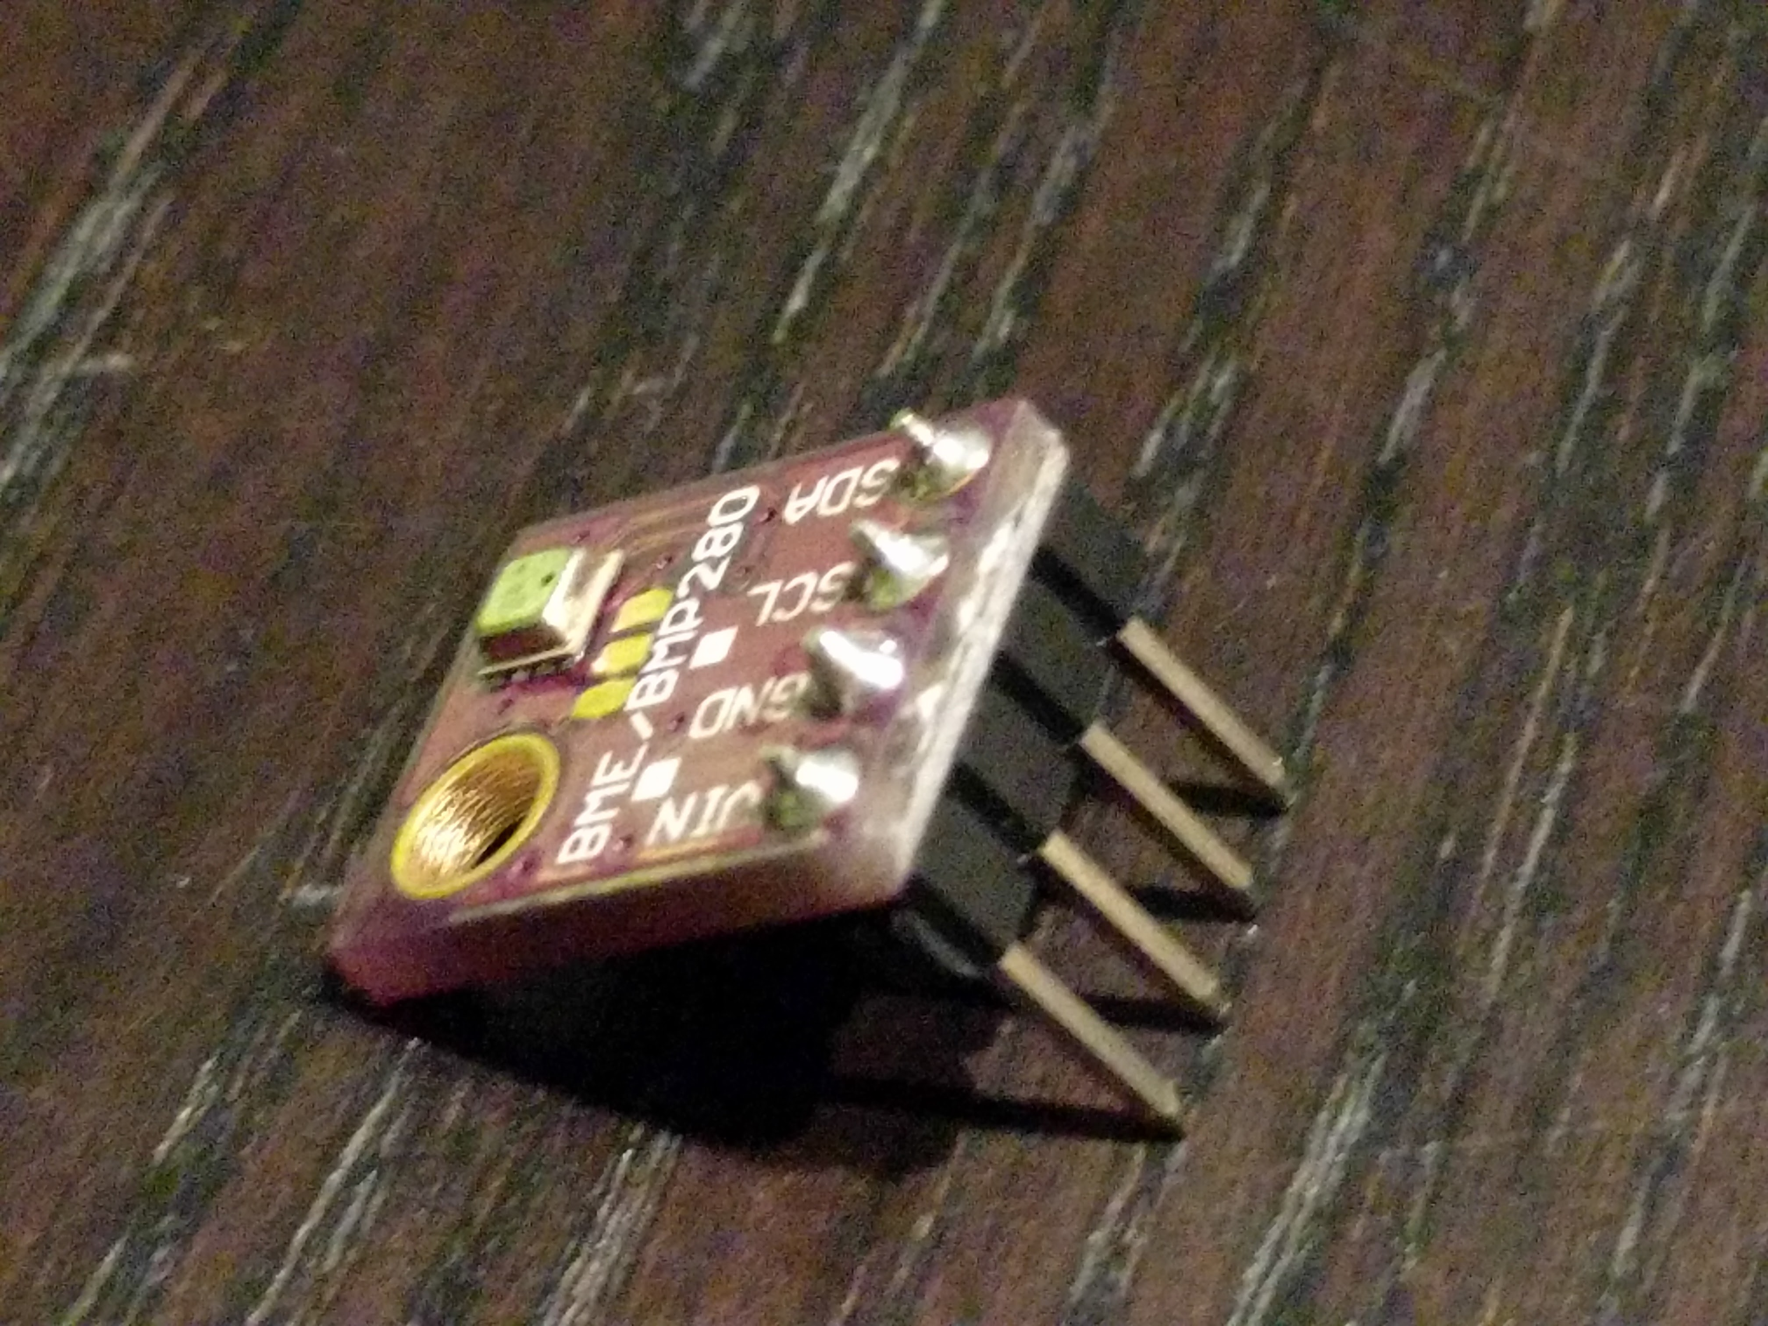
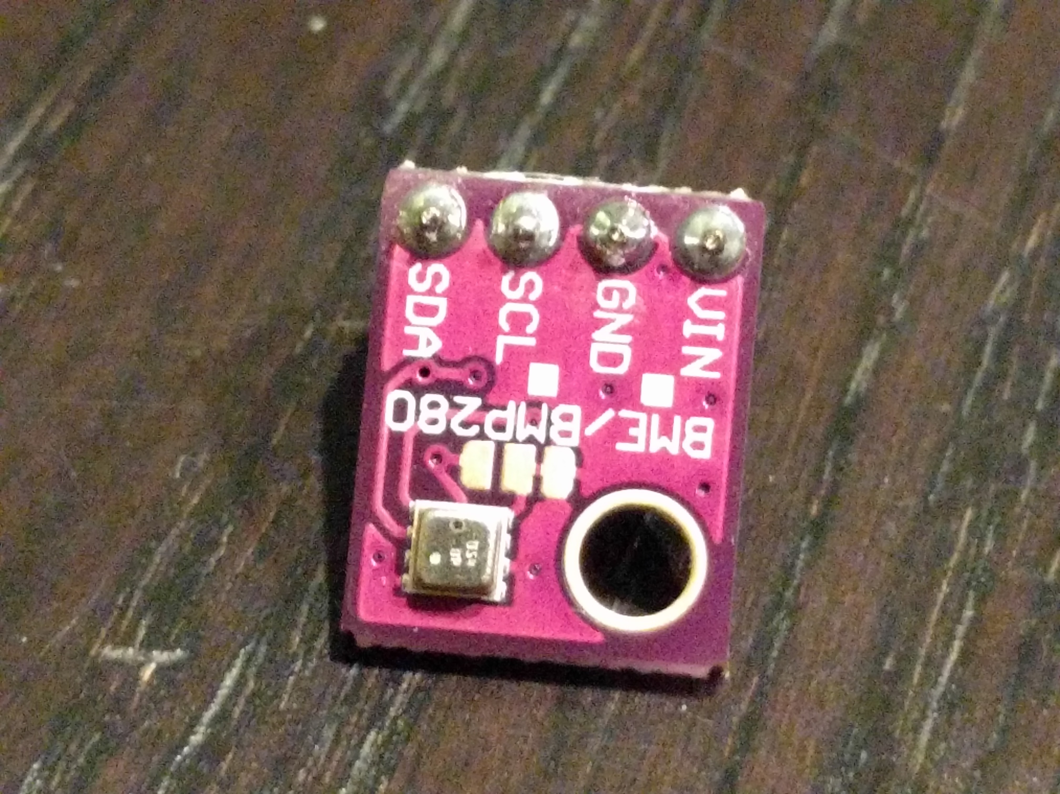
BME/BMP280 Header Attachment

Slide 24
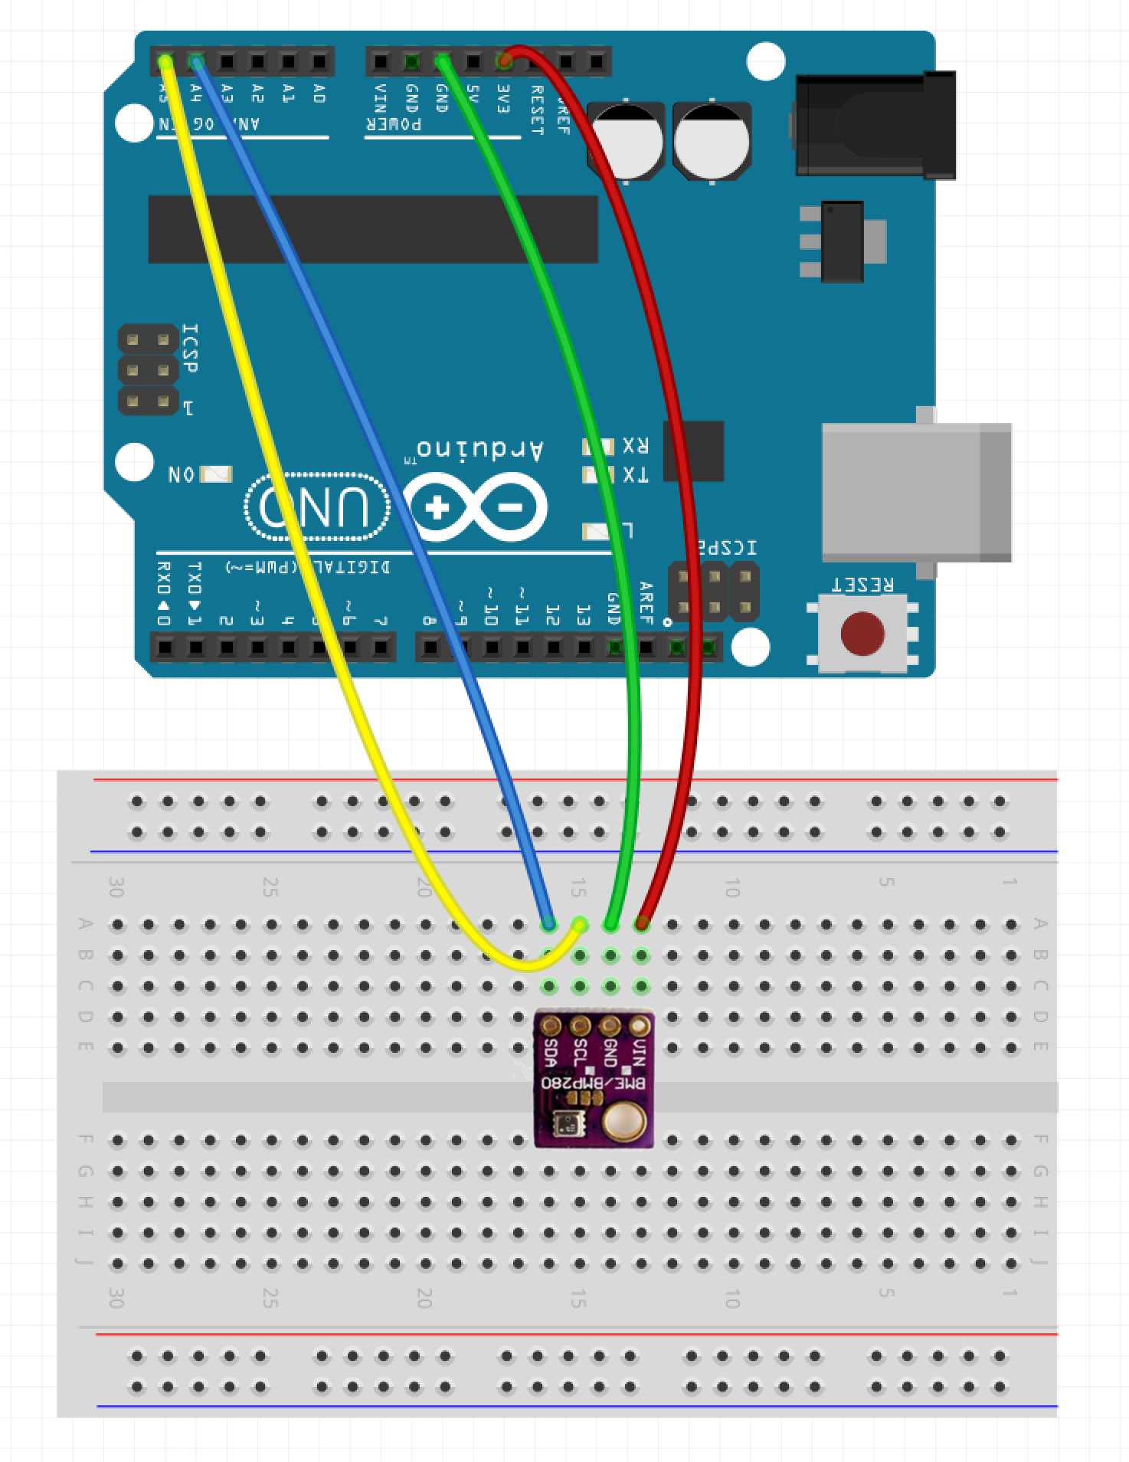
Wire Up BME/BMP280 for Test
GND to A:13 (VIN)
3.3V to A14 (GND)
A5 to A:15 (SCL)
A4 To A:16 (SDA)

Slide 25
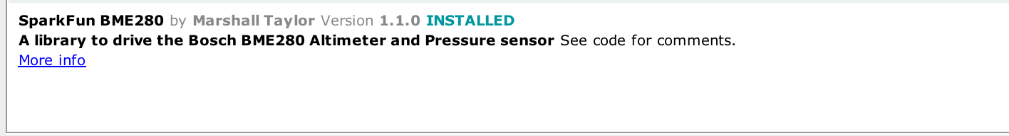
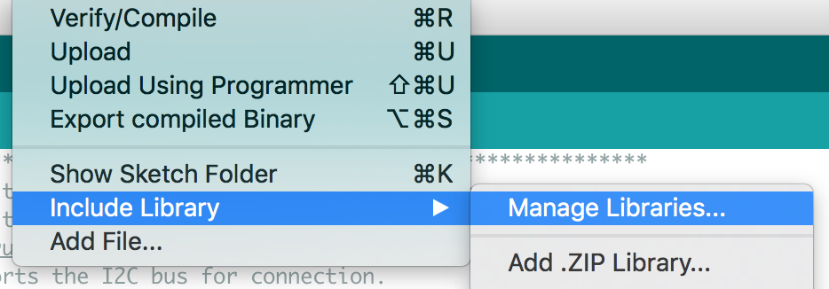
Program Arduino
Go to Sketch -> Include Library -> Manage Libraries
Search for BME
Choose the sparkfun BME280
Open bme280test.ino on the Desktop

Slide 26

Homework
https://thingspeak.com/
Sign Up and create Account
Create Test Channel
Add single field called ’sample’
Directions: https://github.com/borq79/Cary-Area-Public-Library-Classes/wiki

Slide 27

Extra Credit
Flash the nodeMCU with latest Firmware
Modify and load the init.lua and weather.lua scripts
Directions: https://github.com/borq79/Cary-Area-Public-Library-Classes/wiki

Slide 28
Next session
January 19th – 5-6:30 pm
Please bring a USB cable for the NodeMCU if you have one
Bring your own soldering iron and safety goggles if you have them
Schematics and Wiring

